Slide 1
Uncertainty Quantification and Analytical Modeling
Task |  | R&D Area
1.1 |  | Data Management
1.2 |  | User Interface and Search
1.3 |  | Hardware & Network
1.4 |  | Data Transfer
1.5 |  | Installation (Containerized)
1.6 |  | Authentication & Authorization
1.7 |  | Federation
1.8 |  | Quality Control & Assurance
1.9 |  | Replication
1.10 |  | Distributed Search
1.11 |  | Metrics
1.12 |  | User Notification
1.13 |  | Long-tail Publication
1.14 |  | Distributed Computation
1.15 |  | Data Citation
2.1 |  | Provenance Capture
2.2 |  | Workflow
2.3 |  | Dynamic Resources
2.4 |  | In situ Analysis
2.5 |  | Machine Learning
2.6 |  | UQ
2.7 |  | Analytical Modeling
2.8 |  | Mobile Apps
Current capability status:
 | Usable
 | Prototype
 | Research activity
James McEnerney, Ph.D.
Lawrence Livermore National Laboratory
2017 Triennial Project Review, Potomac, MD
June 8 – 9, 2017

Slide 2
Uncertainty Quantification (UQ)
Science of quantitative characterization and assessment of uncertainties in applications
Tools for greater emphasis to understand simulation error
Compute error bars from climate simulations
Assess most sensitive model parameters
Ensemble calculation with low resolution
Derive response surfaces as an estimator

Slide 3
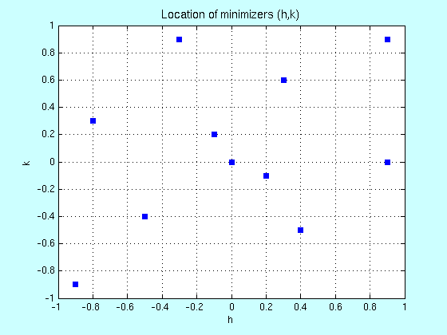
UQ techniques and methodologies
Leverage PSUADE (LLNL) and/or Dakota (SNL)
Toolkits supported by NNSA
Response surface or surrogate model generation methods
Purpose: use these functions instead of the application for output estimate
Requirement: run the application many times for training data
Principle techniques
Multivariate Adaptive Regression Splines (MARS)
Alternate response surfaces based on other generators
Kriging, Radial basis functions, and others

Slide 4

MARS algorithm
Created by Jerome Friedman from Stanford University
late ‘80s-early ‘90s
Algorithm fits a continuous function from an arbitrary training data set
Takes advantage of a specific generator for performance
Serves as an estimator for application output instead running simulation
Python interface to MARS is available in the

Slide 5
Analytical Modeling (AM)
How much time is needed to perform computations in the workflow?
Will it take 5 minutes or 5 weeks to access ESGF data?
Goal: determine best recommendation!
Required for global computing environment
many choices of resource allocation

Slide 6

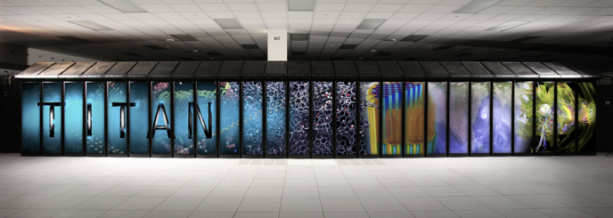
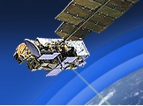
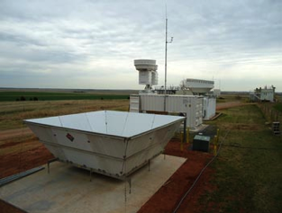

Integrated data ecosystem
Data Collection and Management
Sensors, field and lab experiments
Data models
Transport and communications
Data quality and uncertainty
Storage, provenance and discovery
Security
Provenance
Capture
Enabling integrated research
Data Center and interoperable services
Virtual Laboratory infrastructure
Critical Complex Data Generation Systems
Data Analytics (local & remote)
Descriptive statistics
Graph analytics
Machine learning
Signal and image processing
Pattern discovery
Visualization
Exploratory analysis
Data-Intensive Computing
Architectures – persistent
data to streams
Programming environments
Human computer interface
Decisions and Control
Design Optimization
Policy Making
(Humans)
Understanding and predicting use
Analytical
Modeling
Network

Slide 7
Model the workflow
ESGF Data requirements
Virtual Laboratory
performance data
UQ response surface
Resource
allocation
Performance
archive
Record timing data

Slide 8
Integration into ESGF
Principle interface is through the Virtual Laboratory
Analyze the ESGF data requirements
Recommend resource allocation and utilization
Display a table of resource configurations and performance projections
Operation Modes
Interactive and Automatic
Record actual performance characteristics for subsequent analysis

Slide 9
Summary
Uncertainty Quantification
Improve understanding of application uncertainty
What are the error bars?
Leverage packages: PSUADE and DAKOTA
Analytic Modelling
Provide best timing estimate for end user of virtual laboratory
How does a user distribute their computation efficiently?

